Slide 1
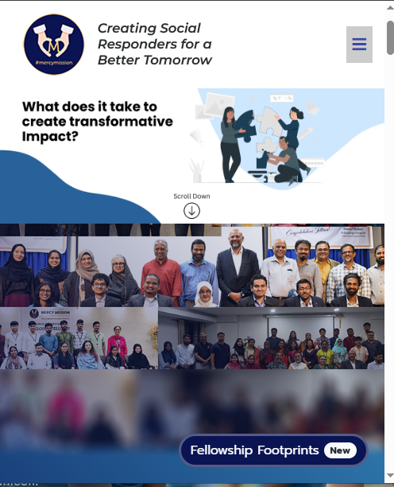
NGO Website – Building Trust, Visibility & Impact
Professional Digital Presence for Social Good

Slide 2
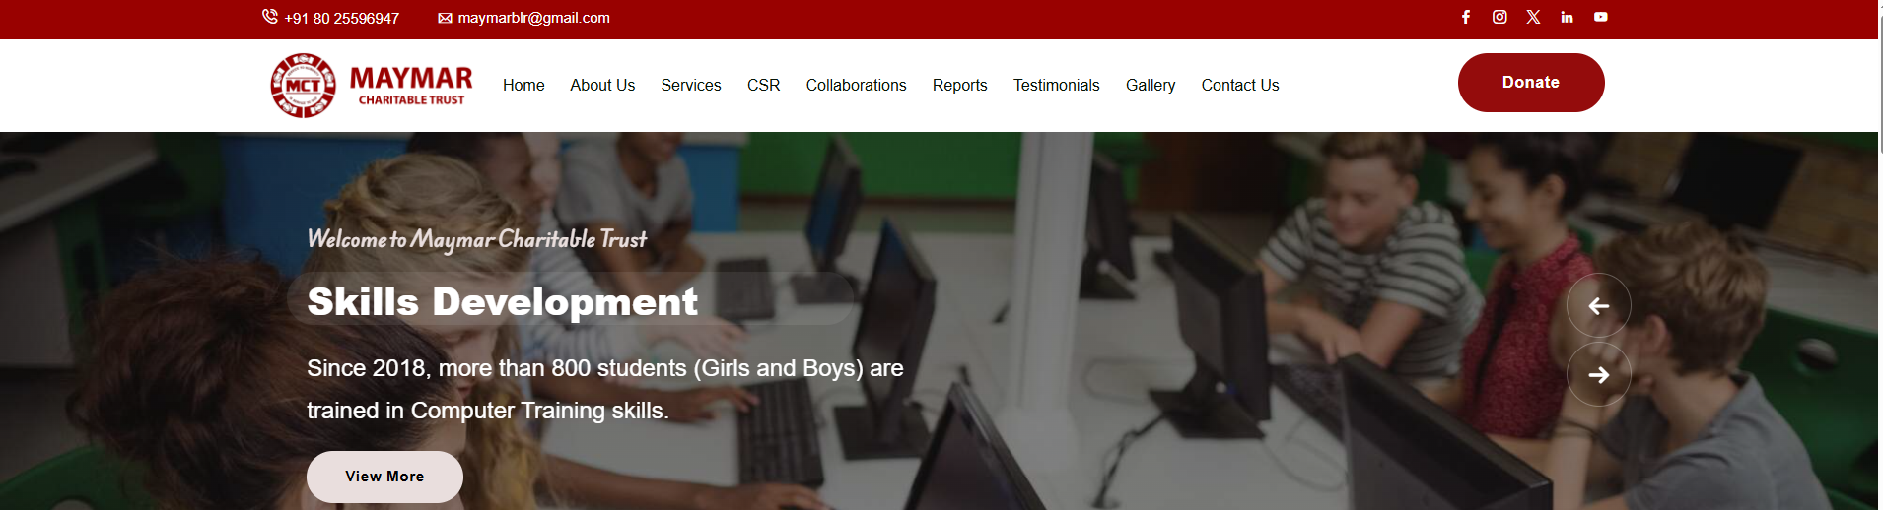
The Need for a Strong Digital Presence
Builds Trust and Credibility
Clearly Communicates Mission and Impact
Acts as a Central Platform for Engagement
A well-designed website establishes legitimacy, reassuring donors, partners, and beneficiaries of your organization's integrity and commitment.
Effectively articulate your purpose, values, and the tangible differences you make in the world, fostering deeper understanding and connection.
Your website serves as the hub for all digital activities, uniting communication, outreach, and community-building efforts in one accessible space.

Slide 3

Homepage: First 5 Seconds Decide Everything
Clear Introduction to Mission and Focus Areas
Strong Visual Storytelling
Utilize compelling images and videos that powerfully illustrate your work and the lives you touch, making your mission resonate on an emotional level.
Immediately convey what your NGO stands for and the critical issues it addresses, creating an instant connection with visitors.
Easy Access to Key Actions
Prominently feature calls-to-action for donations, contact information, and volunteer opportunities, guiding visitors directly to engagement.

Slide 4



About Us: Establishing Legitimacy and Trust
The "About Us" section is crucial for building credibility and fostering donor confidence. It's where potential supporters gain insight into your organization's foundation and values.
NGO Background and Vision
Registration and Legal Information
Leadership and Core Values
Share your origin story, key milestones, and the inspiring vision that drives your work. This personalizes your organization.
Introduce your leadership team and articulate the core values that guide your decisions and actions, showcasing the heart of your mission.
Provide transparent details about your legal status and registrations. This demonstrates accountability and ensures donor peace of mind.

Slide 5
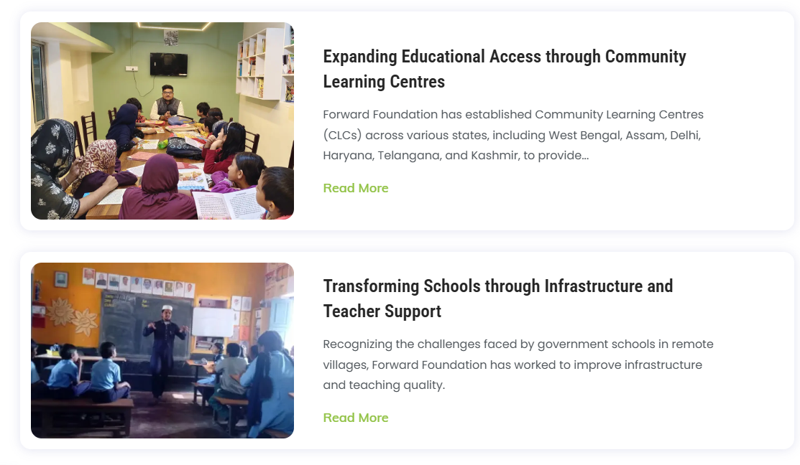
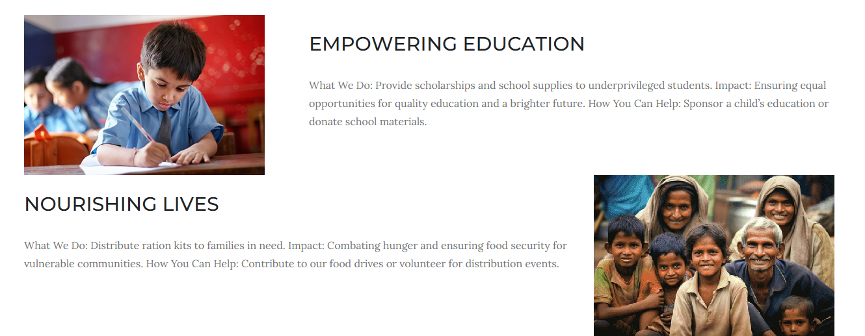
Programs & Initiatives: Showing Real Impact
Translate your efforts into tangible results by showcasing your programs with clarity and compelling evidence of their success.
Clear Listing of Initiatives
Categorize your programs logically, making it easy for visitors to understand the scope and breadth of your work.
Program-Specific Details
Dedicated pages for each program should provide in-depth information, objectives, and target beneficiaries.
Quantifiable Results and Outcomes
Present data, testimonials, and success stories that highlight the measurable impact of your programs on communities and individuals.

Slide 6
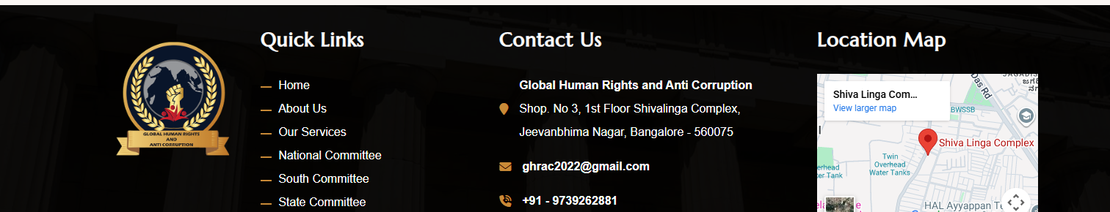
Engagement Features: Making It Easy to Get Involved
Empower your audience to become active participants in your mission through intuitive and accessible engagement pathways.
Volunteer & Partnership Opportunities
Simple Contact and Enquiry Forms
Clear Calls to Action
Strategically placed and compelling calls to action guide visitors towards specific engagement opportunities, from signing up for newsletters to attending events.
Clearly outline various ways individuals and organizations can contribute their time and resources to support your cause.
Streamline communication with easy-to-use forms, ensuring visitors can connect with your team effortlessly for questions or collaboration.

Slide 7
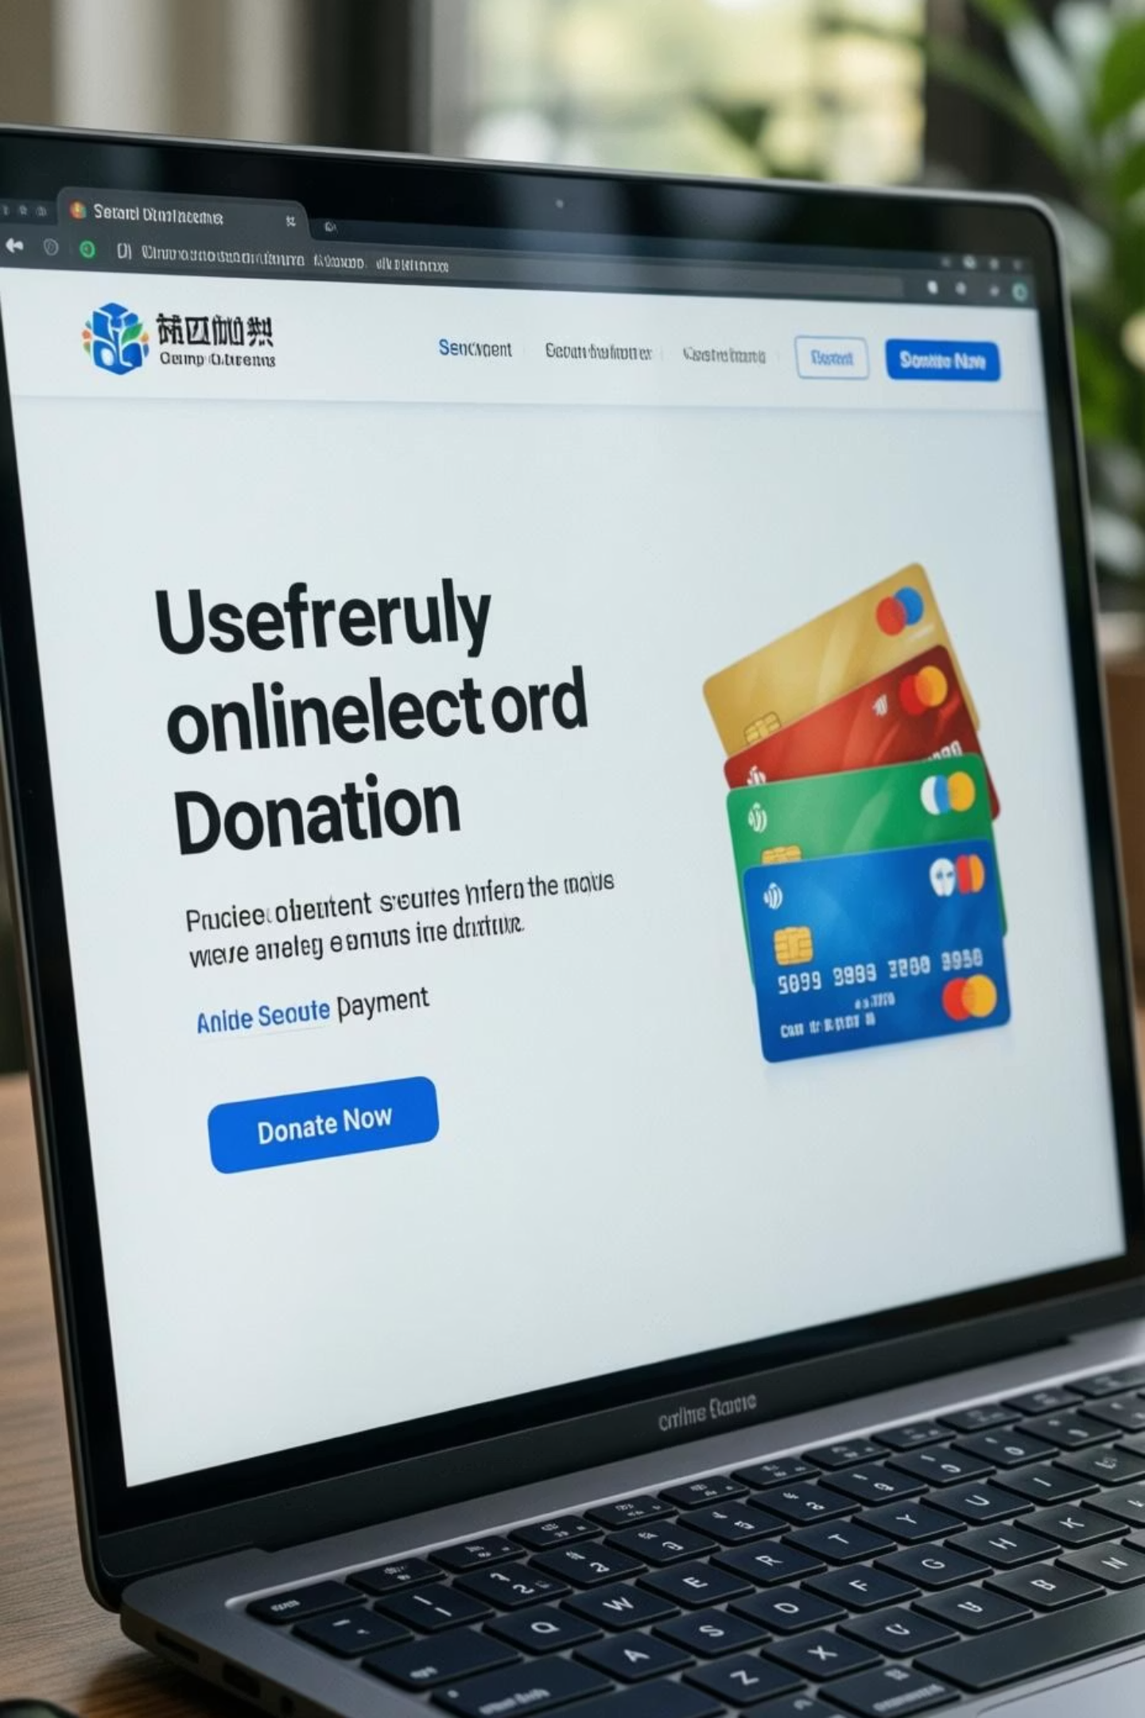
Simplifying Contributions & Support
A smooth and secure donation process is fundamental for converting interest into tangible support, ensuring every contribution is made with confidence.
1
2
Clear Donation Prompts
Cause-Focused Contribution Options
Prominently feature donation buttons and links across the site, making it effortless for supporters to find how to give.
Allow donors to direct their contributions to specific programs or causes, increasing their sense of impact and personalization.
3
Trust-Building Design for Payments
Implement secure payment gateways and clearly communicate security measures, building confidence in the donation process.

Slide 8
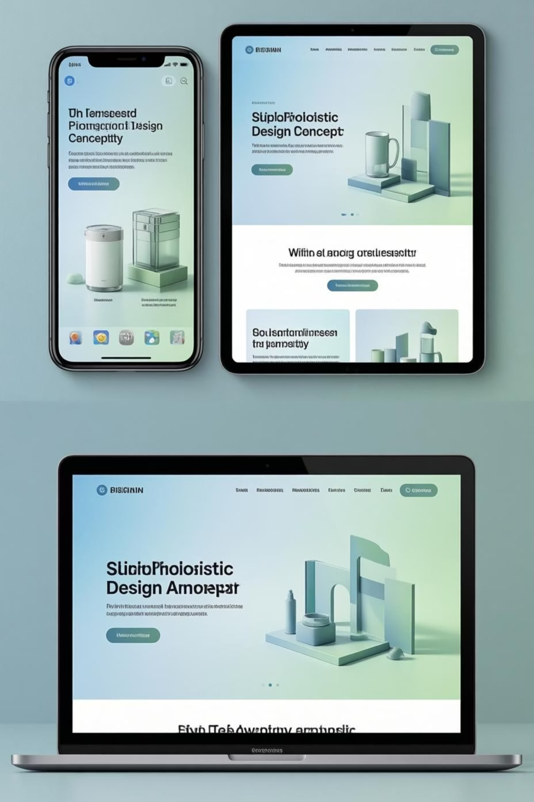
User Experience & Design Quality
A professional website is not just about aesthetics; it's about providing an intuitive, accessible, and enjoyable experience for all users.
1.5s
90%
Intuitive
Fast Loading
Mobile Responsiveness
Simple Navigation
Users expect quick access. Optimized images and code ensure your site loads rapidly, reducing bounce rates.
With most users on mobile, a site that adapts seamlessly to all screen sizes is essential for broad accessibility and engagement.
A clear and logical site structure allows visitors to find information easily, enhancing their overall experience and encouraging deeper exploration.

Slide 9

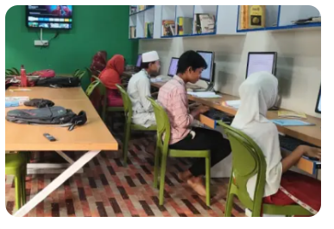

More Than a Website — A Digital Asset
Your website is a dynamic investment that continuously delivers value, evolving with your organization's needs and expanding its reach.
Improves Visibility and Outreach
A strong online presence amplifies your voice, reaching new audiences and expanding your sphere of influence.
Supports Future Growth and Campaigns
The website provides a flexible foundation for launching new initiatives, fundraising drives, and advocacy efforts.
Easy to Maintain and Scale
Built with scalability in mind, your digital platform can grow alongside your NGO, adapting to new programs and increasing traffic without significant overhaul.

Slide 10

A Professional Platform for Meaningful Impact
Investing in a high-quality website is investing in the future of your NGO, solidifying your mission and amplifying your ability to make a difference.
Strengthens Trust and Credibility
A polished online presence projects professionalism, assuring stakeholders of your reliability and dedication.
Increases Engagement and Support
By making interactions intuitive and impactful, your website fosters a vibrant community of supporters and active participants.
Positions the NGO for Sustainable Growth
A robust digital foundation is critical for long-term success, enabling efficient operations, expanded reach, and consistent impact.
Thank You.

Slide 11
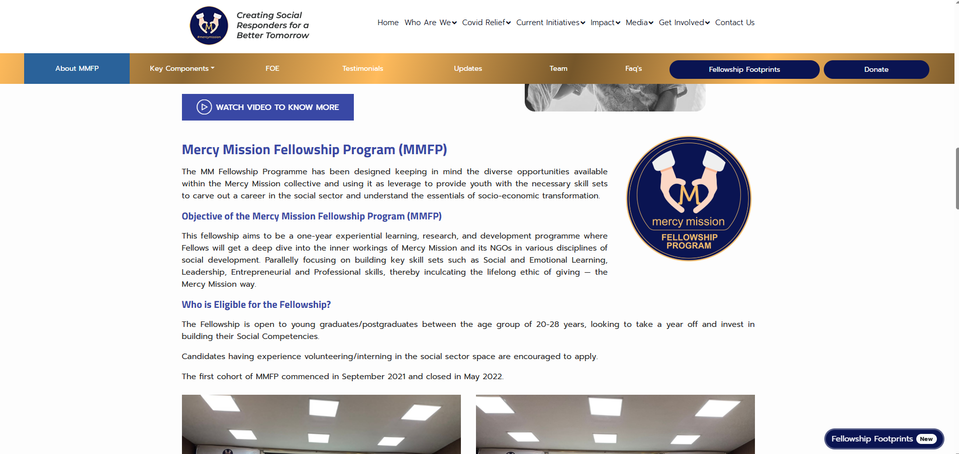
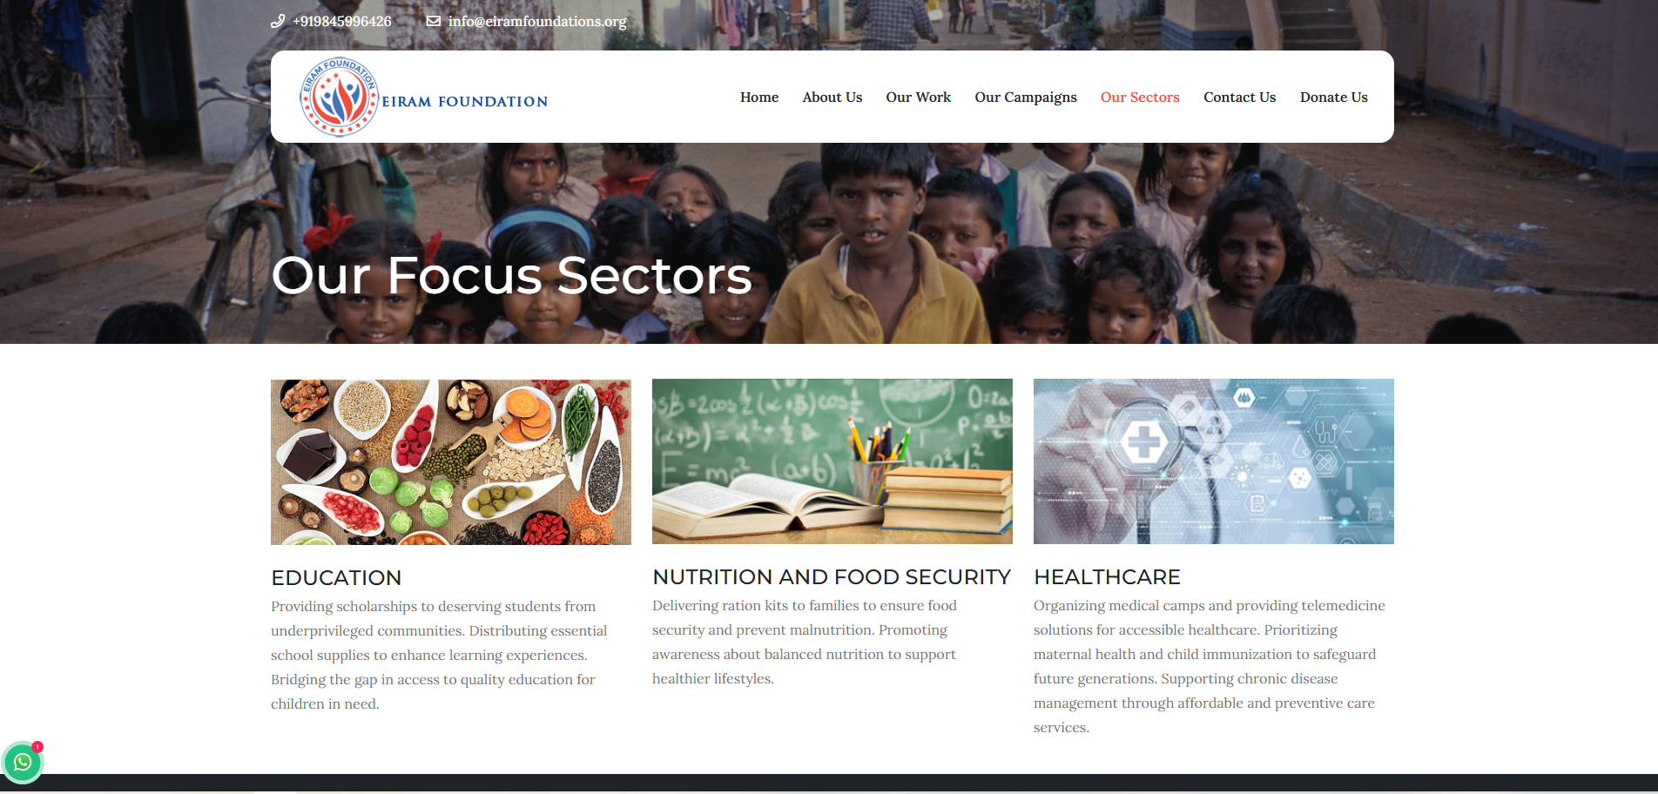
Sample Website layouts

Slide 12
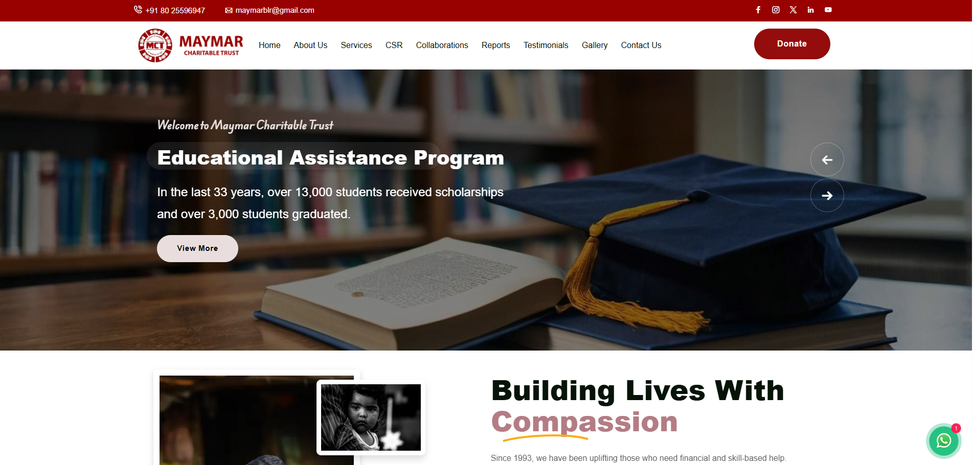
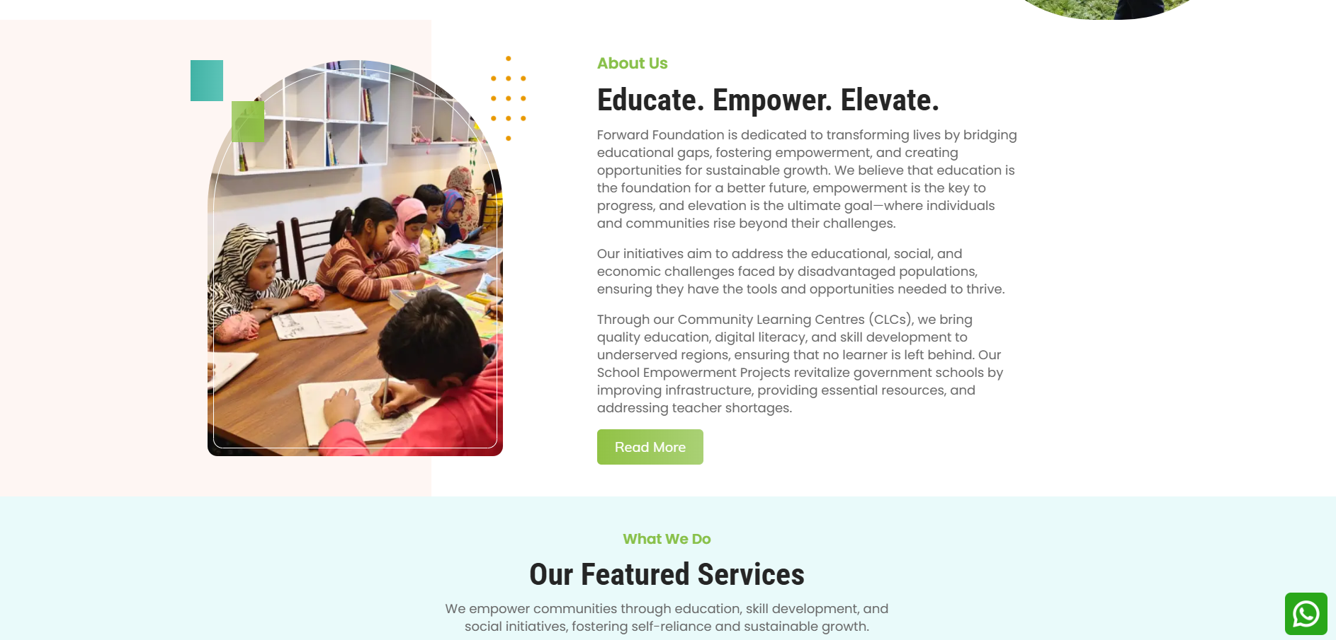

Slide 13

